Slide 1
Works
1
Patch generation tool comparison (PyHIST v.s Slideflow)
2
Tumor detection model cross dataset validation
3
Tissue category map (sliding window algorithm)
4
Finish feature extractor training (pretrained on NCT-CRC-HE-100K)
5
Finish AACR 科技部補助文件

Slide 2
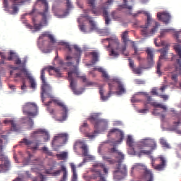
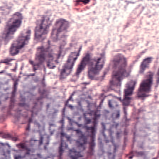
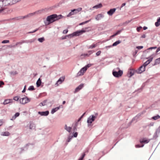
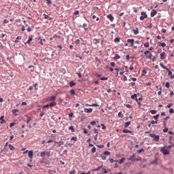
Patch generation tool comparison (PyHIST v.s Slideflow)
Previous problem: PyHIST will magnify the patches abnormally from certain of WSI.
abnormal
normal
Recap: I want to downsample all of the patches into 20x, but the original WSI has wrong magnification label from slideio package. It result in the incorrect parameter setting for PyHIST.
Solution: check magnification label again in mpp (micron/pixel) format from Slideflow. Typically, 0.5 mpp represents 20x, 0.25 mpp represents 40x.
comparison | Pros | Cons
PyHIST | Get grid coordinate conveniently Easily save mask and tile-crossed image | Only do patch generation
Slideflow | Combine tile generation, normalization and quality control into single package | Inconvenient to get grid coordinate

Slide 3
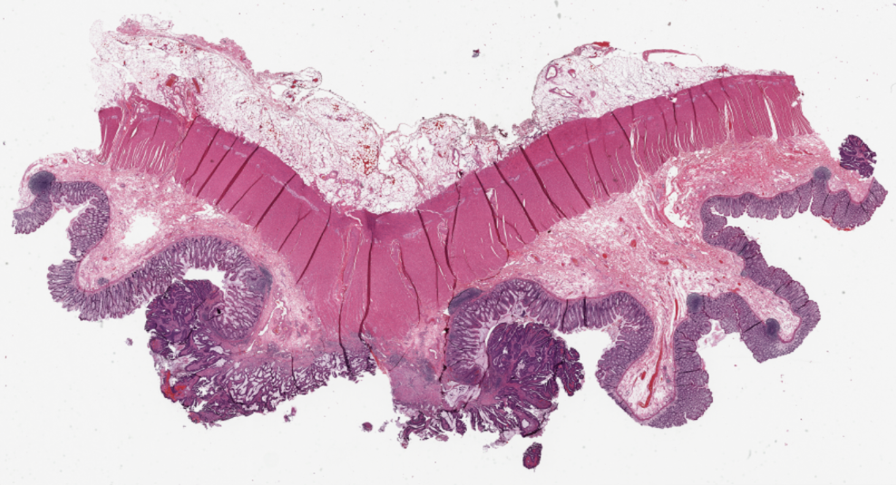
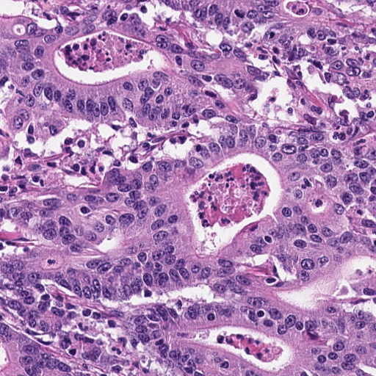
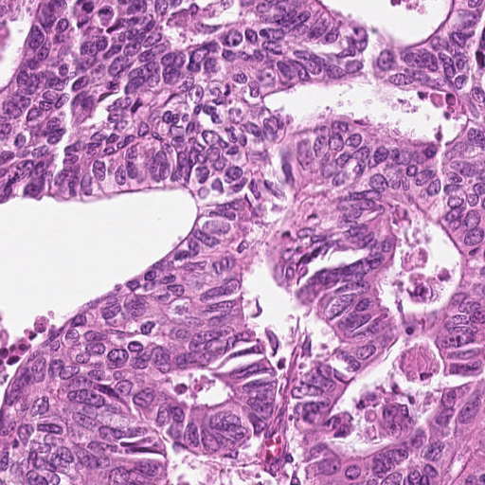
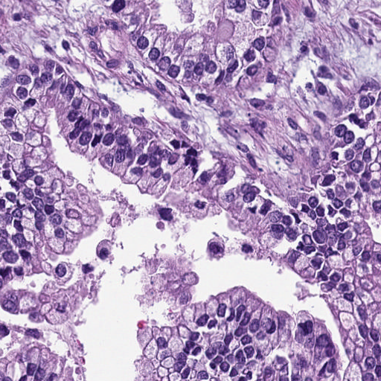
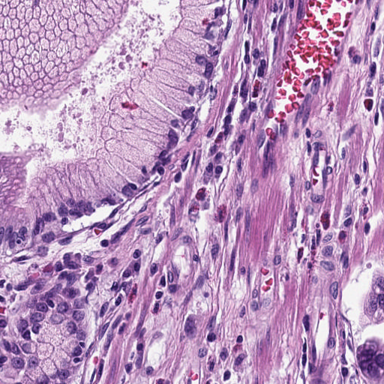
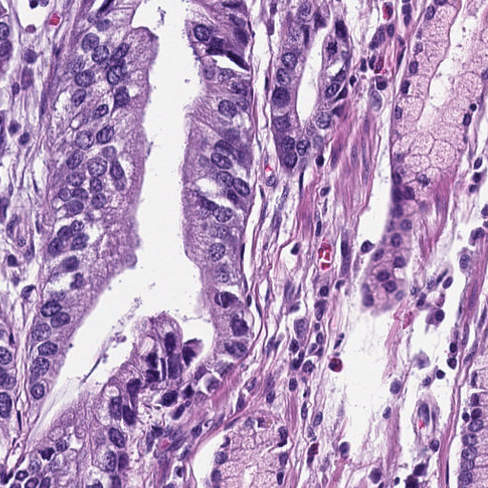
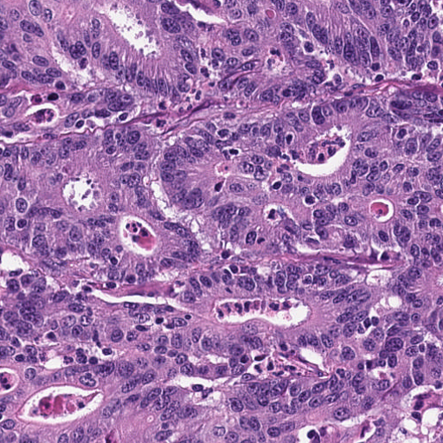
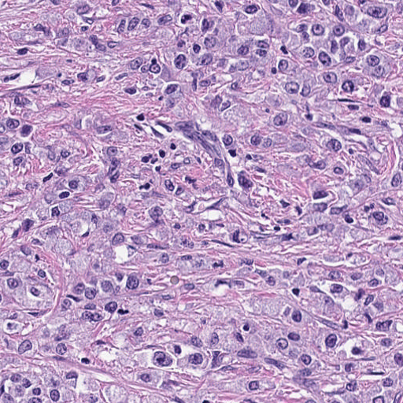
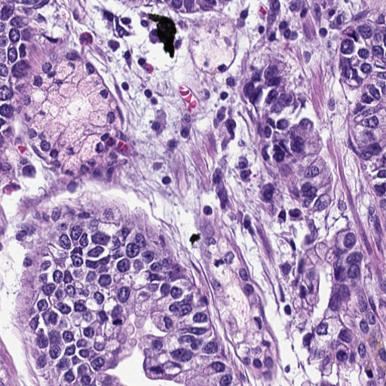
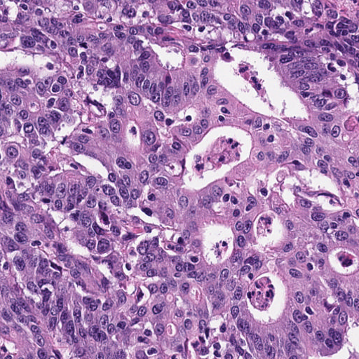
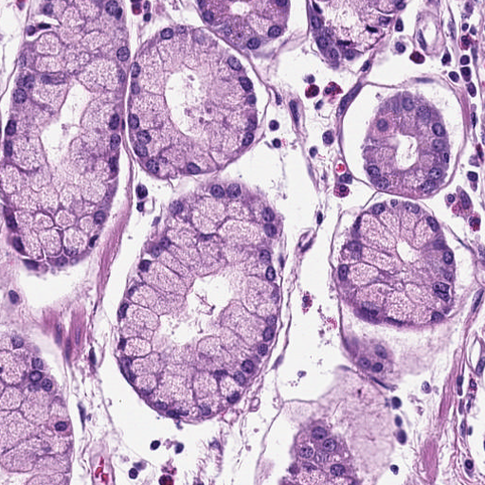
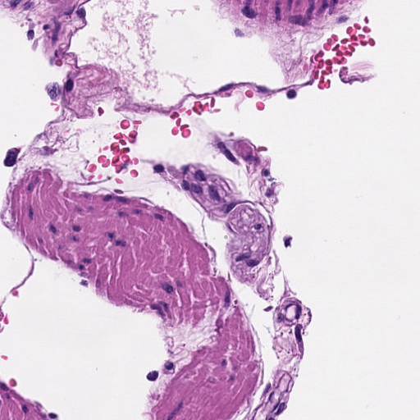
a. Image preprocessing
b. Tumor detection model
c. Feature extraction
TCGA WSIs with molecular label
NCT patches with tissue label
TCGA tumor patches
n
training dataset
testing dataset
Feature extractor
N
2048 dim
……
……
Classification model
n
……
TCGA patches without tissue type label
……

Slide 4
a. Image preprocessing
b. Tumor detection model
c. Feature extraction
TCGA WSIs with molecular label
NCT patches with tissue label
TCGA tumor patches
Cross cohort problem:
train on NCT but inference on TCGA
n
training dataset
testing dataset
We don’ t know whether the classified TCGA tumor patch is correct or not.
Feature extractor
N
2048 dim
……
……
Classification model
n
……
TCGA patches without tissue type label
……

Slide 5
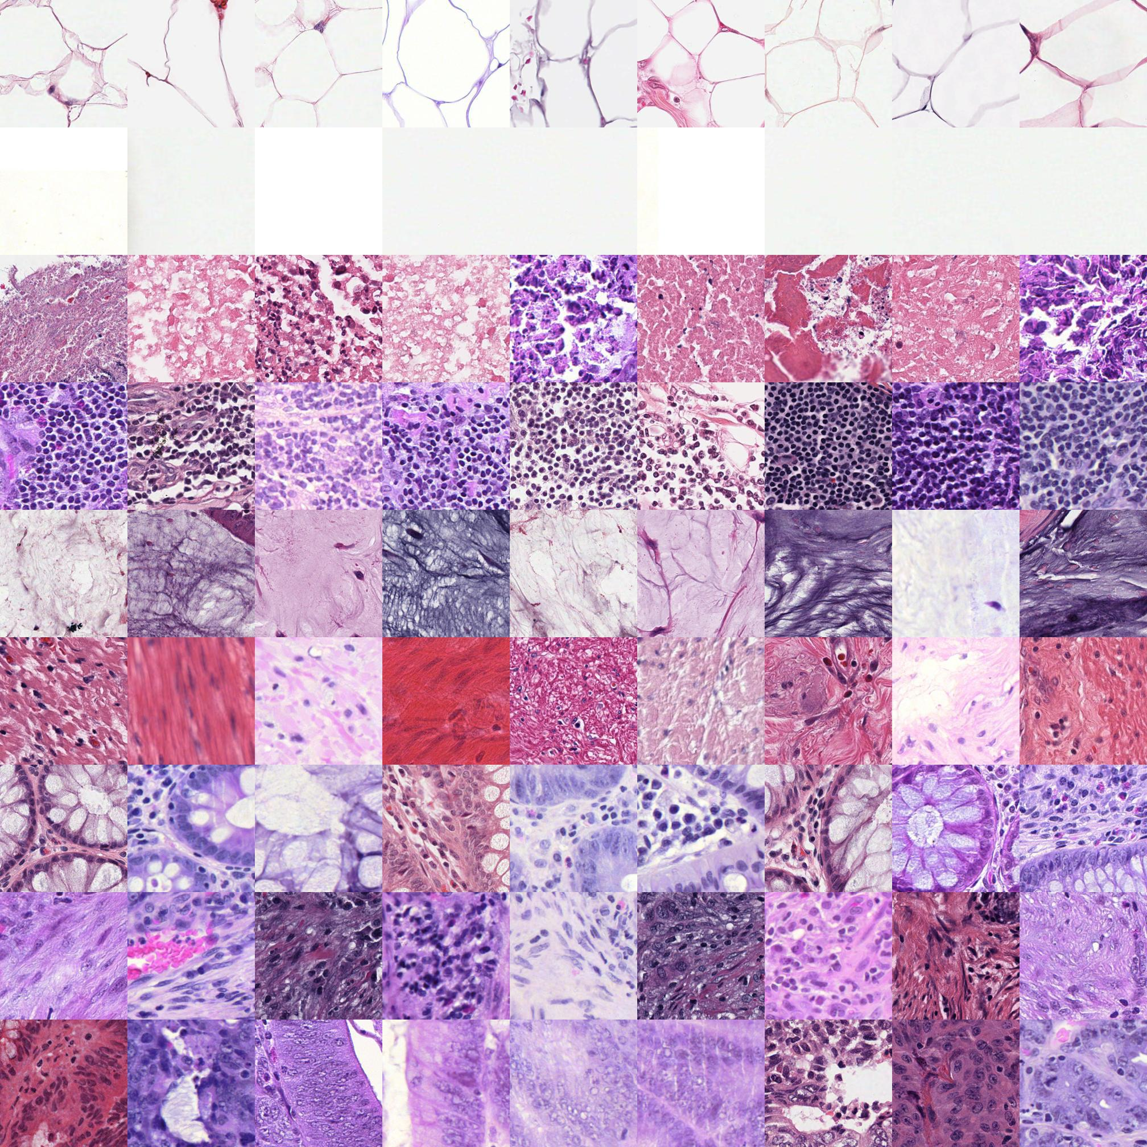
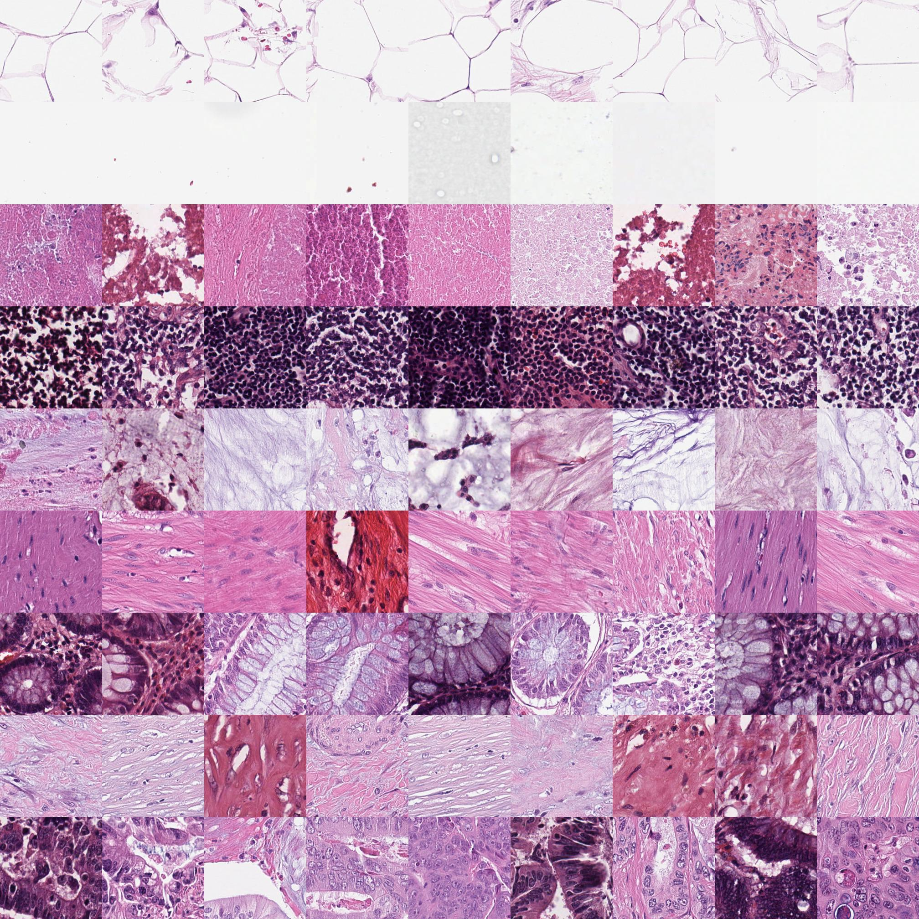
Tumor detection model cross dataset validation
Two different tissue type dataset: TCGA-HE-89K and NCT-CRC-HE-100K
We train two CNN model which are VGG19 and ResNet101. Both VGG19 and ResNet50 have 99% accuracy for internal validation in TCGA-HE-89K and NCT-CRC-HE-100K.
TCGA-HE-89K
NCT-CRC-HE-100K
ADI
BACK
DEB
LYM
MUC
MUS
NORM
STR
TUM

Slide 6
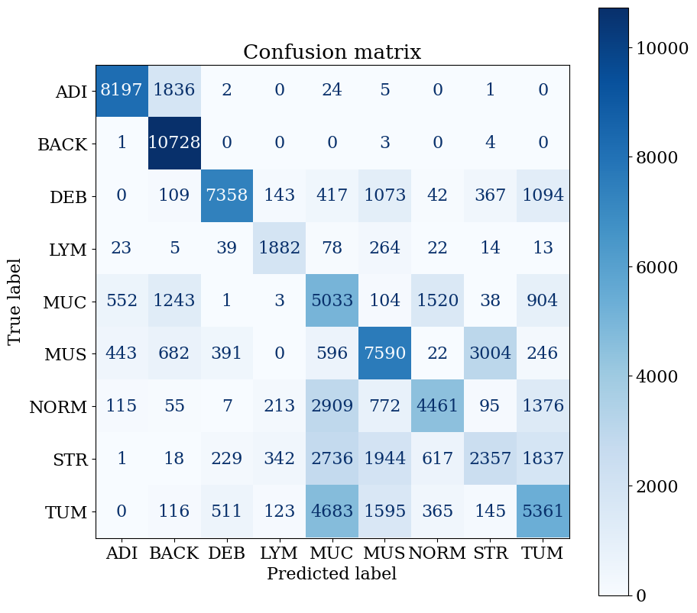
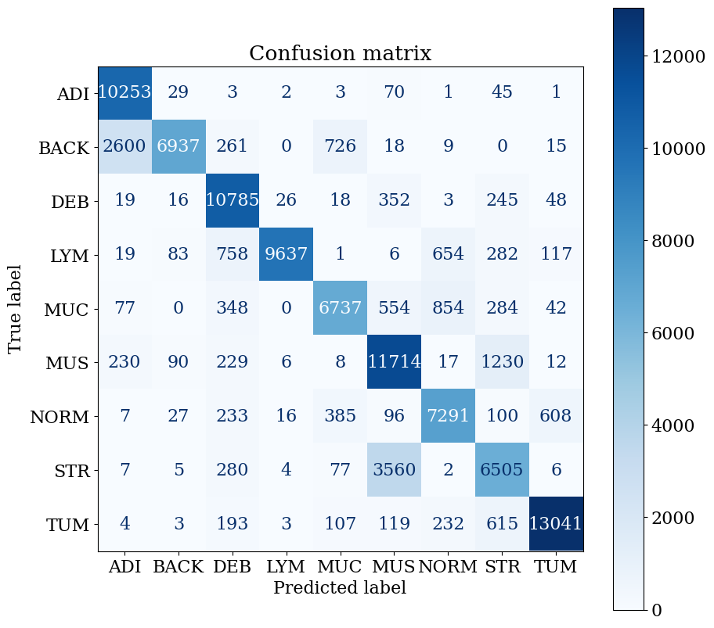
Tumor detection model cross dataset validation (ResNet50)
Left figure: train on NCT-CRC-HE-100K, validate on TCGA-HE-89K and accuracy is 0.595
Right figure: train on TCGA-HE-89K, validate on NCT-CRC-HE-100K and accuracy is 0.829

Slide 7
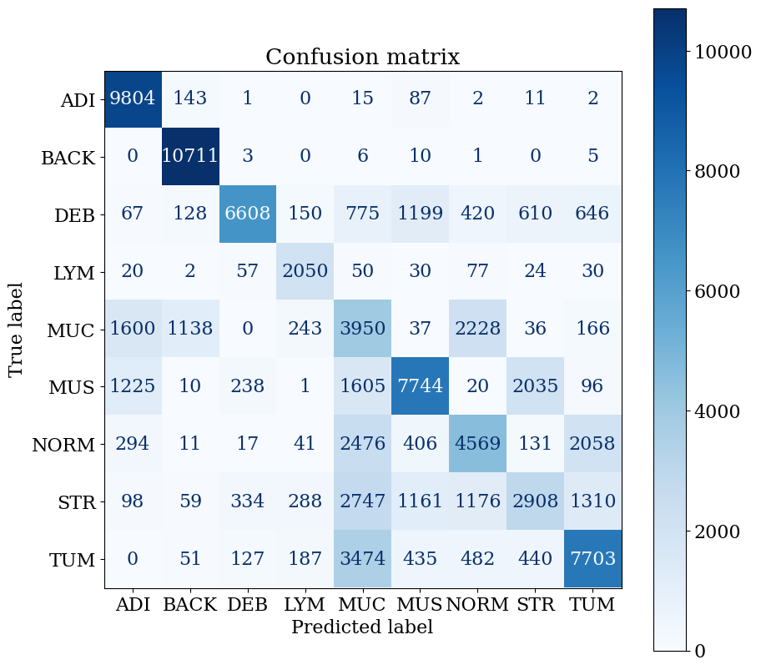

Tumor detection model cross dataset validation (VGG19)
Left figure: train on NCT-CRC-HE-100K, validate on TCGA-HE-89K and accuracy is 0.629
Right figure: train on TCGA-HE-89K, validate on NCT-CRC-HE-100K and accuracy is 0.83

Slide 8
Future works
1
Keep producing additional research results
2
Prepare big lab meeting progress report for next week
3
Make AACR poster

